Slide 1

Identifying Discrimination and Delays in the Lending Decision Process
Lucas Rutledge

Slide 2
Background
Financial Institutions are one of the most widely used tools for households in the U.S.
  “An estimated 4.5 percent of U.S. households (approximately 5.9 million) were “unbanked” in 2021...” (FDIC, 2021)
Banks and credit unions have an abundance of data available to them
There has been a large barrier to utilizing data analytics for consistent success
  Outdated operating systems
  Data security risks
Notes:
The banking industry has some of the most potential for conducting data analysis that is not being utilized by many. In a 2021 study, the FDIC found that only around 4.5% of households in the U.S. were “unbanked”, which is a term to say there was no form of a checking or savings account for the home finances. That said, financial institutions have access to an abundance of datapoints based on the information needed to open and maintain an account. That said, there is a lot of hesitancy in the industry to adopt data analytics into their business operations.
Shalimov (2019) shares two main reasons why institutions are resistant, first it is because their legacy systems used to conduct operations are outdated to handle the data processing, and second because of the risk that an institution takes on by utilizing the data they store. As well, Garg et. al. (2017) shares that over 90 percent of top banks have used advanced levels of analysis, however a large majority of those institutions have failed to replicate that practice into anything sustainable.
Looking at where institutions have begun to delve into the world of analytics, Vivek (2022) shares that the most common uses were to assist in identifying fraud, forecast an institutions status relative to the market, make lending decisions, and detect operational risk.

Slide 3
Business Question and Hypothesis
Question 1 - Is the sample financial institution treating their loan applicants fairly?
  Null: There is no significant relationship between gender, marital status, education level or property area and the chance for loan approval.
  Alternative: There is a relationship between any gender, marital status, education level or property area and the chance for loan approval.
Question 2 - Does the income an applicant has or the amount the applicant is applying for have any significant impact on the application approval?
  Null: There is no significant relationship between either applicant income nor amount applied for and the chance for loan approval.
  Alternative: There is a relationship between either applicant income and/or amount applied for and the chance for loan approval.
Notes:
For this research, I have chosen to investigate the decision-making process in their lending department. When looking at a financial institutions ability to lend, two areas are critical. First, is ensuring that applications are processed and decided on equally for any applicant. Discrimination is a big concern in the industry and has many government regulations such as the Equal Credit Opportunity Act of 1974, Truth in Lending Act of 1968, and Fair Housing Act of 1968. My first research question is revolved around understanding current loan decisions, and asking if there are discriminate practices happening currently? Second, is ability to process loans efficiently and satisfy the individuals needs. One study conducted from interviews of account holders found that “Only 7% of respondents said that their institution could turn around within a week.” (Wooten, 2020). There is opportunity to improve and potentially automate the decision-making process to ensure fast turnaround times with set guidelines. My second research question then asks if there is any relationship between an applicant's income, or the amount they are looking to take in a loan, and the decision given?

Slide 4
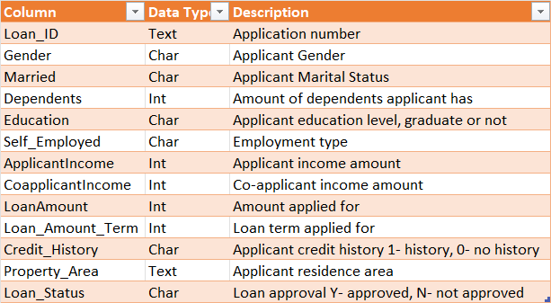
Data Source
Figure 1: Dataset Dictionary
Loan_Approval_Prediction Dataset
The dataset has 13 variables and 614 rows with each representing an application.
8 variables are categorical, with grouped values with two or more possible outcomes. 5 variables are numerical, with an interval-based outcome.
Private information is excluded to ensure data security and protection of the applicants.
Notes:
The dataset is titled Loan_Approval_Prediction. This set has 13 columns of variables, and 614 rows which each represent an applicant. Of the 13 variables 8 of them are categorical, meaning that their values can have two or more possible outcomes. These would then represent groups in the dataset. The other 5 variables are numerical, which means that they can have infinite interval values.
As previously mentioned, one reason why financial institutions are hesitant to further their use of analytics comes from the risk of exposing personal identifying information to fraud. For this reason, any information such as an applicants name, their contact information, spending habits, and social security number have all been excluded from this study.

Slide 5
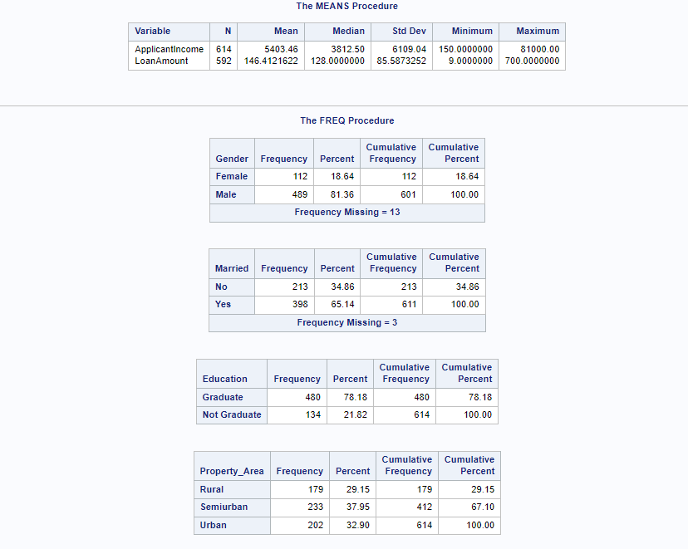
Summary of Test Data
Figure 2: Statistic Summary and Frequency Analysis
Question 1 – Loan_Status, Gender, Married, Education, Property_Area
Question 2 – Loan_Status, ApplicantIncome, LoanAmount
SAS® Studio used to process dataset
Notes:
With the research questions identified, and dataset collected and refined, we can begin to explore the dataset. For question 1, I have chosen to look at the connections of gender, marital status [Married], Level of Education, and area of residence [Property_Area]. These were chosen as they all pertain to an area of the applicants life that would be protected by anti-discrimination laws. These are all categorical variables, and therefore frequency analysis can be used to interpret the quantity and percentage for each of the groups. For question 2, I am utilizing applicant income [ApplicantIncome], and the amount of the loan applied for [LoanAmount]. These are factors that dictate if a loan is at risk to be repaid. Both values are numerical, and descriptive statistics can be used to find the mean data. We use SAS® Studio to conduct our analysis.

Slide 6
Methodology
Chi-square test of independence
Kruskal-Wallis test
Used to test if a relationship exists between two categorical variables
Compares observed frequencies of groups to expected frequencies for each
P-value tested against significance level
Relationship between a categorical and numerical variable
Tests by ranking the means of all groups present
P-value tested against significance
Notes:
Because each question looks at different types of data, different tests are required to be used. For the first question, the Chi-square test of independence will be used, as it tests if a relationship exists between two categorical variables. According to a UCLA report, this compares the observed frequencies of groups to the expected (null) frequency to determine test statistic and p-value. Meanwhile, the second question will use the Kruskal-Wallis test, which is used to test for a relationship between a categorical variable and a numerical variable, assuming the numerical is not normally distributed. This tests by ranking the means of all groups present, and again produces a p-value. The p-value is a statistic that assumes the p-value assumes the null hypothesis is correct and obtains results at least as extreme as the observed results from the test. This is then compared to a significance level usually around a=0.05.

Slide 7

Results
There are significant relationships that suggest discrimination in approval odds
- Married, Education, Property_Area
There is no significant evidence that a relationship between applicant income or loan amount is present
Notes:
The findings from the tests were able to reject the null for three of the variables and fail to reject three as well. For our first question, the data suggests that marital status, education level, and residence all have a relationship to the loan application decision. A relationship would then mean that the decision of that loan is tied to one of these discriminatory factors and suggests there is discrimination in the dataset. For the second question, neither applicant income nor loan amount had sufficient evidence to suggest an alternative to the null. Therefore, we are unable to suggest a relationship between these variables and the loan approval odds which does not allow us to use these as a loan guideline.

Slide 8
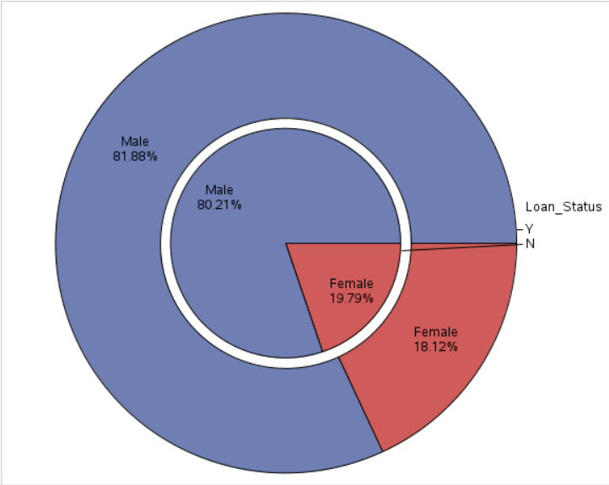
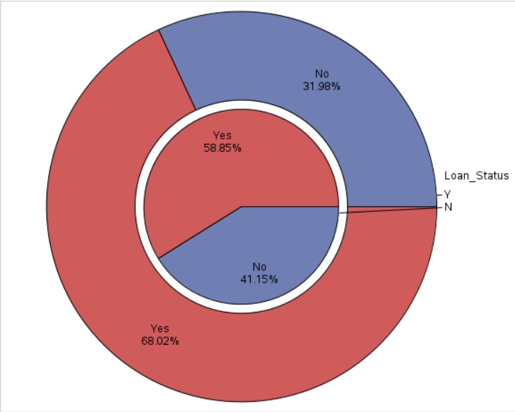
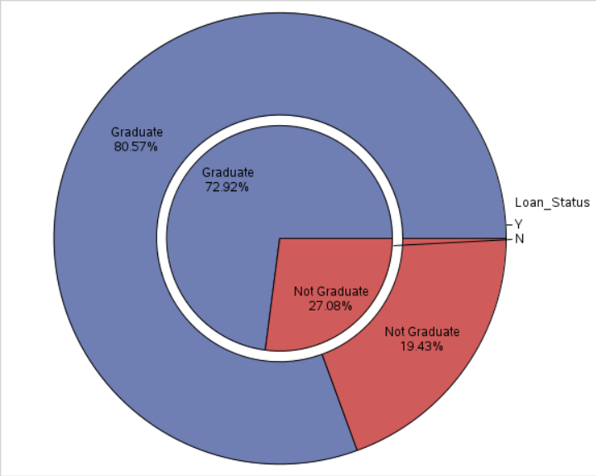
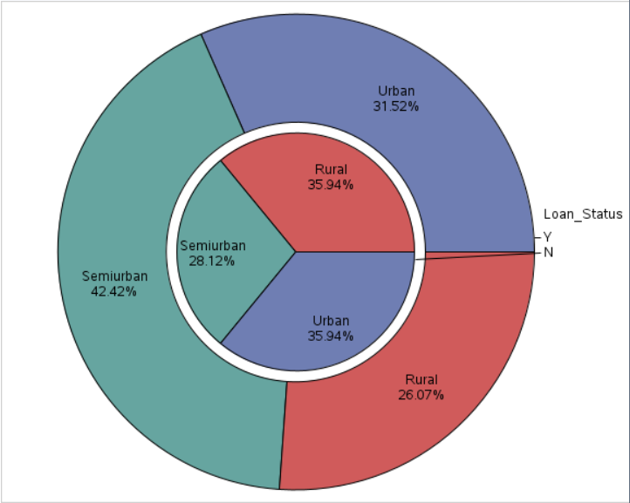
Visualizations Question 1
Gender Pie Chart
Married Pie Chart
Gender is roughly equivalent between groups
Married, Education, Property_Area all appear skewed
Education Pie Chart
Property_Area Pie Chart
Notes:
Visualizing the data for question 1, we can use pie charts to break down the groups. Each chart looks at one of the four variables chosen to assess the question, with a sub-grouping around the loan decision. Starting with Gender, we can see a similar frequency between groups who were approved and those who were not. For Married, we see that loans that ~32% applicants that were approved for their loan were not married, but that increases by almost 10% when looking at those who were declined. Similar for Education, there was an 8% increase of those declined for a loan that did not graduate. And for Property_Area, we can see that Semiurban residents had a 14% increase in getting approved, while Rural residents saw a ~10% decrease in approval.

Slide 9
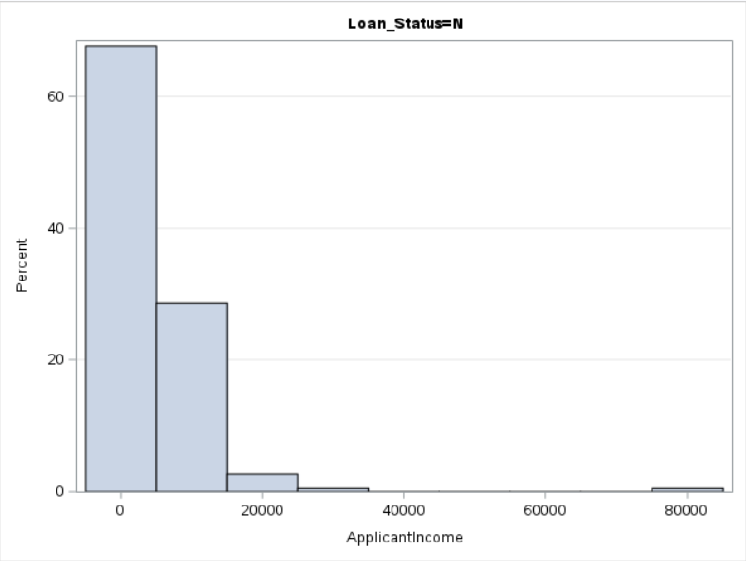
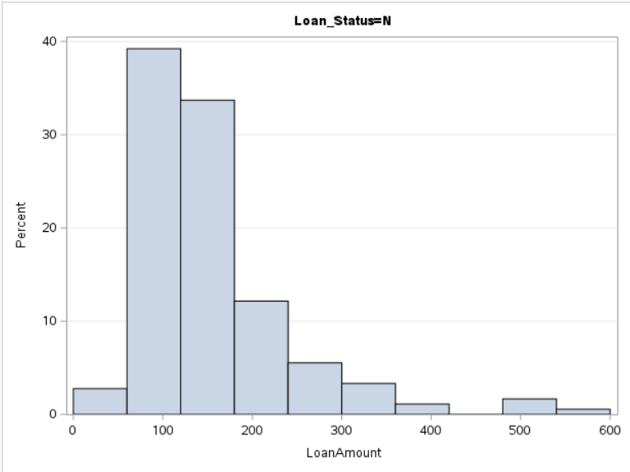
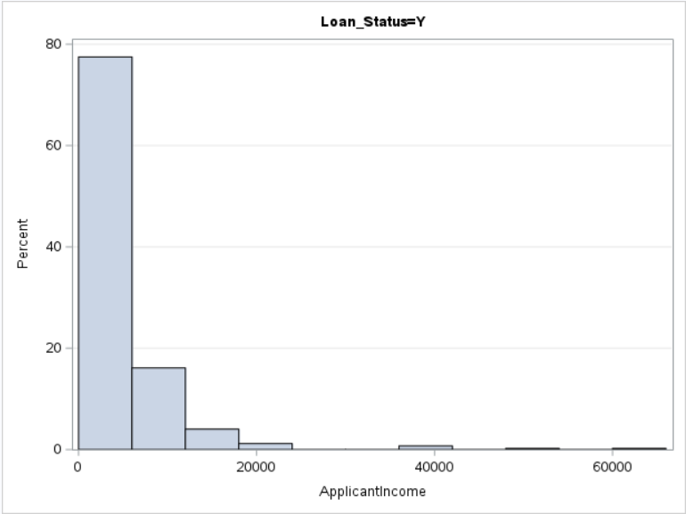
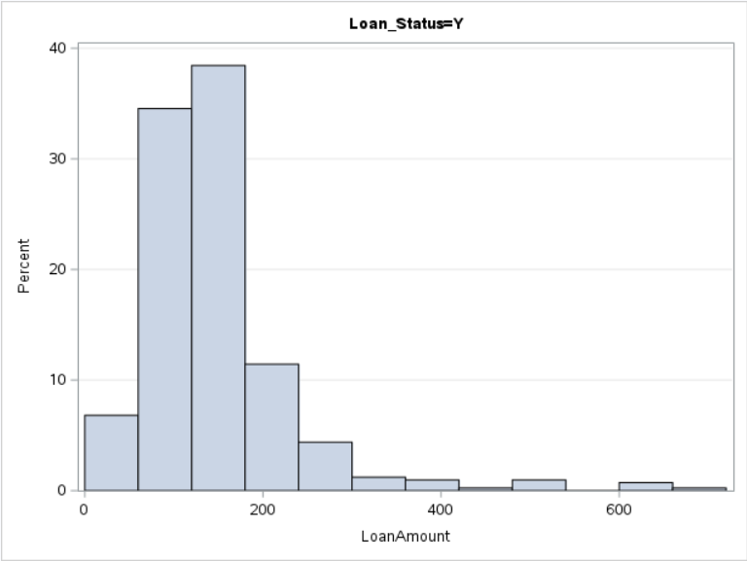
Visualizations Question 2
ApplicantIncome Histogram
LoanAmount Histogram
ApplicantIncome is congregated mostly between 0-20,000 in both Approved and Not Approved
LoanAmount collects mostly between 100-200 in both Approved and Not Approved
Notes:
Assessing the results for the second question, histograms are useful here to compare the means data. Starting with income, we see that for both groups approved and declined for loans, the large majority of their income fall between 0-10,000, and pretty much all of it is distributed the same between 0-20,000. As for LoanAmount, we see that the two largest peaks for both approved and declined loans are at 100-150, with the majority of data between 100-200.

Slide 10
Limitations
Limited variables to test
  No further detail into racial components to test discrimination
  Not enough credit variables that can affect a loan decision to test
Relatively small sample of applicants
Notes:
There are limitations to the data that could impact the findings. The dataset overall had limited variables to test which could help better understand each question. For the first question regarding discrimination, the topic of race was unable to be reviewed due to lack of data. This is one of the largest areas of concern for many, and a study by Bartlett et. al. (2019) found that due to discrimination in interest rates on home loans, African-American and Latinx applicants’ were charged ~$750 million more each year in interest payments. As well, for our second question, we were unable to identify any significant relationship for variables that are input for a loan relationship to the actual approval. However, there are more than just income and amount reviewed for a decision. The data was unable to collect information such as granular credit history, loan purpose, and existing capital/equity all play a vital role too.
As well, the sample data collected was relatively small compared to the identified population usage. 614 total applicants reviewed could just not be enough to make accurate population estimations.

Slide 11
Recommendations
There was sufficient evidence that discrimination could be present in an applicant's marital status, level of education, and area of residence
  Greater levels of training regarding fair lending
  Test for secondary correlations (do these factors correlate to income?)
The research suggests no alternative to the assumption that income and loan amount correlate to approval odds
  Additional loan factors could be identified and collected for testing
  Increased sample could alter findings of existing hypothesis
  No found relationship could indicate why loan decisions take as long as they do
Notes:
This research found that there was sufficient data to suggest that there is discrimination present in current loan decisions. This can come with large consequences if identified and not addressed. Having this information can give direction to the institution leadership on areas where the team is currently failing to adhere to fair lending practice. This can then help identify training opportunities and promote better culture surrounding those areas. As well, while the research did not prove relationships to optimize the loan process with the data currently, this does not mean that it was a failure. It just means that the data we currently have does not signify an alternative. Collecting additional applicant data, or including more fields as mentioned previously could find new relationships and answer more questions going forward. As well, we can take these findings as true for now, and eliminate the possibility of these two variables as having a large impact. Not having a relationship proven here could indicate why loans take as long as they do currently, and could lead to other process improvements to try and correct this.

Slide 12
References
Bartlett, R., Morse, A., Stanton, R., & Wallace, N. (2019). Consumer-lending discrimination in the Fintech Era. FDIC. https://doi.org/10.3386/w25943
Garg et al. (2017, June 22). Analytics in Banking: Time to realize the value. McKinsey & Company. Retrieved March 26, 2023, from https://www.mckinsey.com/industries/financial-services/our-insights/analytics-in-banking-time-to-realize-the-value.
2021 FDIC National Survey of Unbanked and Underbanked Households. (2022, November 14). FDIC. Retrieved May 7, 2023, from https://www.fdic.gov/analysis/household-survey/index.html#:~:text=The%202019%20survey%20finds%20that,was%20first%20conducted%20in%202009.
Shalimov, A. (2019, January 19). Big Data in the banking industry: The main challenges and use cases: Eastern peak. Eastern Peak - Technology Consulting & Development Company. Retrieved March 26, 2023, from https://easternpeak.com/blog/big-data-in-the-banking-industry-the-main-challenges-and-use-cases/
Vivek, J. (2022, August 22). Data Analytics in banking and Financial Services. Zuci Systems. Retrieved March 26, 2023, from https://www.zucisystems.com/blog/how-is-data-analytics-used-in-finance-and-banking-sector/
What Statistical Analysis Should I Use? Statistical Analyses Using SAS. OARC Stats. (n.d.). Retrieved November 6, 2022, from https://stats.oarc.ucla.edu/sas/whatstat/what-statistical-analysis-should-i-usestatistical-analyses-using-sas/#:~:text=A%20chi%2Dsquare%20test%20is,and%20its%20associated%20p%2Dvalue
Wooten, K. (2020, March 19). 5 ways to overcome lending inefficiencies to prepare for economic uncertainty. Banking Exchange. Retrieved April 9, 2023, from https://www.bankingexchange.com/management-topics/item/8172-5-ways-to-overcome-lending-inefficiencies-to-prepare-for-economic-uncertainty
The data analysis for this paper was generated using SAS software, Version 3.8 of the SAS System for Linux. Copyright © 2012-2018 SAS Institute Inc. SAS and all other SAS Institute Inc. product or service names are registered trademarks or trademarks of SAS Institute Inc., Cary, NC, USA.

